Slide 1
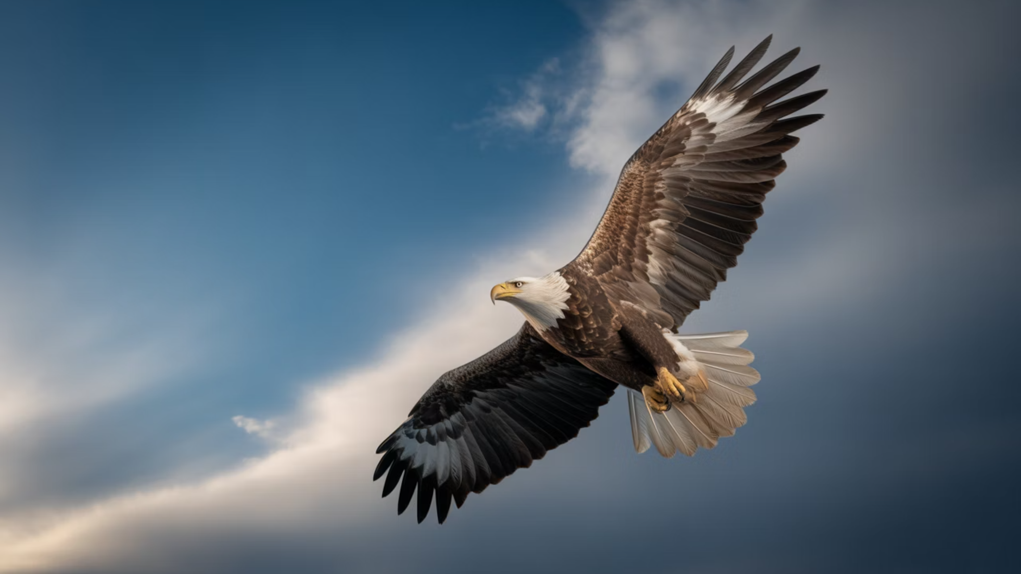


Slide 2

Theme Scriptures
Amos 3:7
Jeremiah 27:18a
Ephesians 6:18,19
Surely the Lord God does nothing, Unless He reveals His secret to His servants the prophets.
But if they are prophets, and if the word of the Lord is with them, let them now make intercession to the Lord of hosts, that the vessels which are left in the house of the Lord, in the house of the king of Judah, and at Jerusalem, do not go to Babylon.
Praying always with all prayer and supplication in the Spirit, being watchful to this end with all perseverance and supplication for all the saints – and for me, that utterance may be given to me, that I may open my mouth boldly to make known the mystery of the gospel,

Slide 3
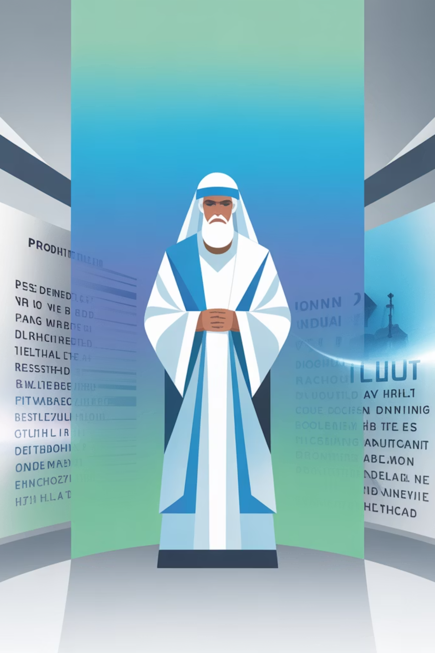
Why Pray for the Prophets?
1
We value the Word of the Lord – Matthew 4:4
2
We value the Word & Spirit Model – Acts 13:1-3
3
Due to Spiritual Warfare – Ephesians 6:12
4
Note the Devil’s Schemes – 2 Corinthians 2:11
5
Where there is No Vision – Proverbs 29:8
6
Extra Sensitive by Gifting and Nature – Proverbs 18:14
7
We value the Breaker Anointing – Micah 2:13

Slide 4

Day 1: Pray for Purity and Integrity
Day 2: Pray for Intimacy with God
10 Day Prayer Guide
Day 3: Pray for Boldness and Courage
Day 4: Pray for Discernment and Clarity
Day 5: Pray for Humility and Accountability
Day 6: Pray for Physical and Emotional Strength
Focus • Scripture • Prayer
Day 7: Pray for Protection from Spiritual Attacks
Day 8: Pray for the Prophetic Mantle to be Honored
Day 9: Pray for the Fulfillment of Prophetic Words
Day 10: Pray for Revelation of God's Plans

Slide 5
More Resources to Serve You
Great Graphics
Global Prayer Storm Podcasts
Global Prayer Storm Articles
GEM Books and Resources
10 Day Prayer Guide
Updates on Online Prayer Events
prayfortheprophets.com
globalprayerstorm.com

Slide 6


Recommended Books
GLOBAL PRAYER STORM
THE LIFESTYLE OF A PROPHET

Slide 7



